Slide 1






Developing ‘Vocabulary’ &
Supporting ‘Active Listening’ in the
Secondary School
‘What?’ to teach …
‘How?’ to teach it …
Notes:
KEY POINT: The words chosen to learn are important, but equally as important if not more important is to ‘Learn’, ‘Apply’ and ‘Monitor’ the questions contained within the mind-map to enable the student to apply the questions to new vocabulary they encounter in order to learn, memorise and ultimately understand and use that new vocabulary. Thus developing their vocabulary!

Slide 2

Developing ‘Vocabulary’ in the Secondary School
‘What?’ to teach …
‘How?’ to teach it …

Slide 3

Developing ‘Vocabulary’ in the Secondary School
‘What?’ words should we teach …

Slide 4
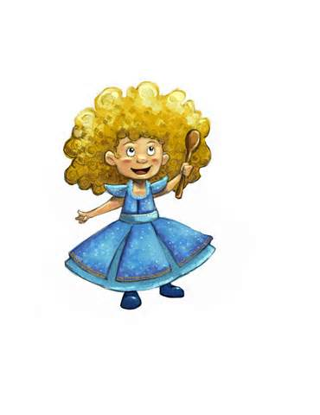
Developing ‘Vocabulary’ in the Secondary School
‘What?’ words should
we teach ……?
‘Goldilocks Words’;
… words that are not too easy, not too hard – just right!

Slide 5
Developing ‘Vocabulary’ in the Secondary School
‘What?’ words should we teach …
‘
Tier 1 | Tier 2 | Tier 3
Words used in everyday speech Students with a limited vocabulary will need support | General Academic words Words found more often in written texts across disciplines | Domain specific words Words found more often in written texts within a specific discipline.

Slide 6
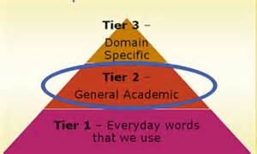
Developing ‘Vocabulary’ in the Secondary School
‘What?’ words should we teach …

Slide 7
Developing ‘Vocabulary’ in the Secondary School
‘Tier 2’ words are;
Critical to understanding texts
Are highly generalisable across all content areas
Require deliberate effort to learn; unlike Tier 1 words

Slide 8
Developing ‘Vocabulary’ in the Secondary School
‘Tier 2’ words are;
Critical to understanding texts
Are highly generalisable across all content areas

Slide 9
Developing ‘Vocabulary’ in the Secondary School
‘Tier 2’ words;
Require deliberate effort to learn; unlike Tier 1 words
Are far more likely to occur in written texts, rather than speech

Slide 10
Developing ‘Vocabulary’ in the Secondary School
‘Tier 2’ Words;
Represent subtle or precise ways of saying otherwise relatively simple things
Are seldom heavily scaffolded by authors, unlike Tier 3 words

Slide 11




Developing ‘Vocabulary’ in the Secondary School
Tier 1 Words;
Words used in everyday speech
Students with a limited vocabulary will need support
Tier 2 Words;
General Academic words
Words found more often in written texts across disciplines
Tier 3 Words;
Domain specific words
Words found more often in written texts within a specific discipline.
Circulation:
… the transport of oxygenated blood through the arteries to the capillaries, where it nourishes the tissues, and the return of oxygen depleted blood through the veins to the heart, where the cycle is renewed.

Slide 12



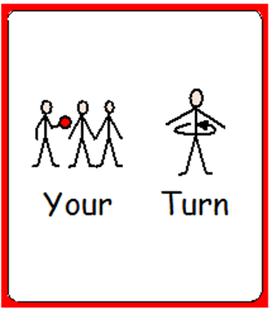


Developing ‘Vocabulary’ in the Secondary School
‘How’ should we teach these
words …..?

Slide 13


Developing ‘Vocabulary’ in the Secondary School
‘How’ should we teach those
words …..?
Top Tip 1: Write the ‘Taught Words’ on the whiteboard
Text ONLY

Slide 14
Developing ‘Vocabulary’ in the Secondary School
Circulation: … the transport of oxygenated blood ….
Top Tip 1: Write the ‘Taught Words’ on the whiteboard
Text ONLY

Slide 15


Developing ‘Vocabulary’ in the Secondary School
‘How’ should we teach those
words …..?
Top Tip 1: Write the ‘Taught Words’ on the whiteboard
Text (Highlighting Key Vocabulary)

Slide 16
Developing ‘Vocabulary’ in the Secondary School
Circulation: … the transport of oxygenated blood ….
Top Tip 1: Write the ‘Taught Words’ on the whiteboard
Text (Highlighting Key Vocabulary)

Slide 17


Developing ‘Vocabulary’ in the Secondary School
‘How’ should we teach those
words …..?
Top Tip 1: Write the ‘Taught Words’ on the whiteboard
Text (Highlighting Key Vocabulary, with Picture Cues)

Slide 18

Developing ‘Vocabulary’ in the Secondary School
Circulation: … the transport of oxygenated blood ….
Top Tip 1: Write the ‘Taught Words’ on the whiteboard
Text (Highlighting Key Vocabulary, with Picture Cues)

Slide 19
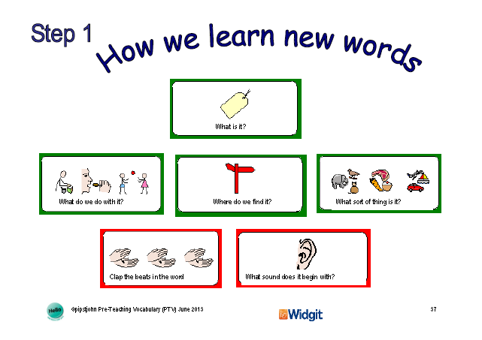


Developing ‘Vocabulary’ in the Secondary School

Slide 20

Developing ‘Vocabulary’ in the Secondary School

Slide 21
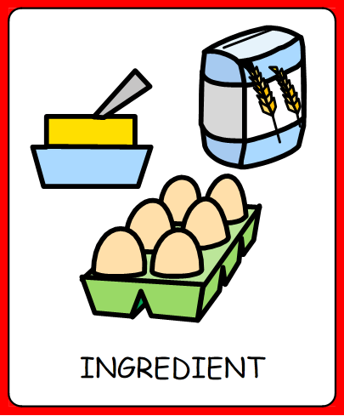
Developing ‘Vocabulary’ in the Secondary School
Notes:
Now you can have a go at answering the questions, (STEP 1), let’s take things easy, one step at a time!

Slide 22
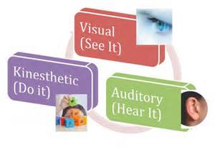
Developing ‘Vocabulary’ in the Secondary School
Notes:
How do we ‘Teach’ and ‘Learn’ the strategies?;
‘Which strategy is missing?’
‘Which strategies are next?’
‘Place the strategies in the correct order/placement’

Slide 23

Developing ‘Vocabulary’ in the Secondary School
Notes:
‘What is missing?’; ask the question that is ‘missing’ from this slide.
- with/without a complete ‘Mind-Map’

Slide 24

Developing ‘Vocabulary’ in the Secondary School
Notes:
‘What is Next?’; ask the question that is ‘next’ in this slide.
with/without a complete ‘Mind-Map’

Slide 25
Developing ‘Vocabulary’ in the Secondary School
Notes:
‘Place all the question cards down on the table in the correct order’; ask each question as you lay it down.
with/without a complete ‘Mind-Map’

Slide 26

Developing ‘Vocabulary’ in the Secondary School
Staff/Students to ‘Teach’/ ‘Learn’ the questions within the Pre-Teaching Vocabulary (PTV) Pack

Slide 27

Developing ‘Vocabulary’ in the Secondary School
Staff/Students to ‘Model’/ ‘Apply’ the questions within the Pre-Teaching Vocabulary (PTV) Pack

Slide 28

Developing ‘Vocabulary’ in the Secondary School
Staff/Students to ‘Assess’ the students use of / ‘Monitor’ successful application of the questions within the Pre-Teaching Vocabulary (PTV) Pack

Slide 29
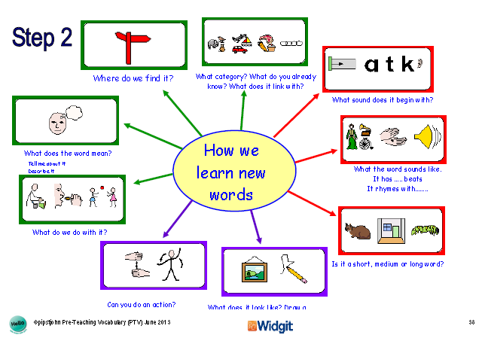
Developing ‘Vocabulary’ in the Secondary School
Notes:
Step 2, consists of questions from Step 1 – plus some more!

Slide 30
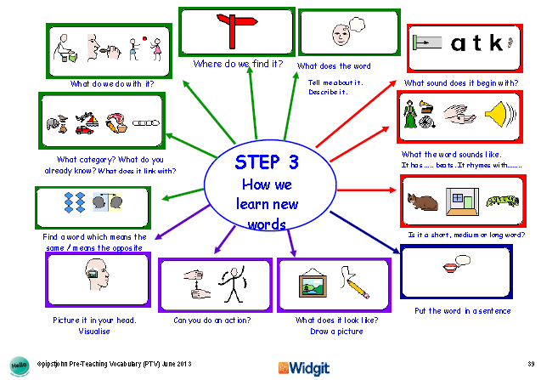
Developing ‘Vocabulary’ in the Secondary School
Notes:
Step 3 consists of questions from Step 2, plus some more. It also includes the need to ‘Put the word into a sentence.’ Explain that it is ‘very difficult’ to do this unless you can already answer the ‘Green Box’ questions: ‘Green for what it means.’

Slide 31
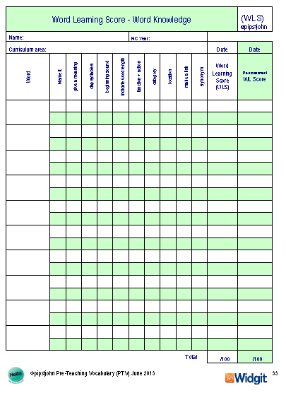
Developing ‘Vocabulary’ in the Secondary School
Notes:
Explain that this a pre- and post-intervention assessment grid. It consists of questions which feature in the mind-maps in Steps 1-3;
Some questions are worded differently, in different Steps – not ideal!
Some visual cues change, from step to step, for the same question – not ideal!

Slide 32
Developing ‘Vocabulary’ in the Secondary School
Assessment | Step 1 | Step 2 | Step 3
1. Name it | ‘What is it?’
2. *Give a meaning. (Definition) |  | ‘What does the word mean? Tell me about it. Describe it’ | ‘What does the word mean? Tell me about it. Describe it’
3. Clap Syllables | ‘Clap the beats in the word.’ | ‘What the word sounds like. It has … beats. It rhymes with …’ | ‘What the word sounds like. It has … beats. It rhymes with …’
Notes:
Teachers/Students both need to familiarise themselves with the questions in both the mind-maps and the pre- and post-intervention assessment.

Slide 33
Developing ‘Vocabulary’ in the Secondary School
Assessment | Step 1 | Step 2 | Step 3
4. Beginning Sound | ‘What sound does it begin with?’ | ‘What sound does it begin with?’ | ‘What sound does it begin with?’
5. Indicate Word Length. | ‘ | ‘Is it a short, medium or long word?’ | ‘Is it a short, medium or long word?’
6. Function & Action |  | ‘Can you do an action?’ ‘What do we do with it?’ | ‘Can you do an action?’ ‘What do we do with it?’

Slide 34
Developing ‘Vocabulary’ in the Secondary School
Assessment | Step 1 | Step 2 | Step 3
7. Category | ‘What sort of thing is it?’ | ‘What category?’ | ‘What category?’
8. Location | ‘Where do we find it?‘ | ‘Where do we find it?‘ | ‘Where do we find it?‘
9. Make a Link |  | ‘Make a Link’ | ‘Make a Link’

Slide 35
Developing ‘Vocabulary’ in the Secondary School
Assessment | Step 1 | Step 2 | Step 3
10. Synonym |  |  | ‘Find a word which means the same’

Slide 36
Developing ‘Vocabulary’ in the Secondary School
‘Who’ should we teach those words to ……?

Slide 37
Developing ‘Vocabulary’ in the Secondary School
‘Who’ should we teach those words to ……?
Tier 1 or 2 Words: Students identified with a ‘Limited vocabulary’ or a ‘Word Finding Difficulty’

Slide 38

Developing ‘Vocabulary’ in the Secondary School
‘Who’ should we teach those words to ……?
Tier 1 or 2 Words: Students identified with a ‘Limited vocabulary’ or a ‘Word Finding Difficulty’

Slide 39
Developing ‘Vocabulary’ in the Secondary School
‘Who’ should we teach those words to ……?
Tier 3 Words: Students with sufficient understanding of Tier 2 words

Slide 40
Developing ‘Vocabulary’ in the Secondary School
Further Reading;
http://www.phschool.com/eteach/language_arts/2002_03/essay.html
- Teaching Vocabulary Across the Curriculum (see Communication & Interaction Lead Person; Natalie Bianchi)

Slide 41
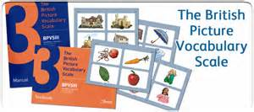
Developing ‘Vocabulary’ in the Secondary School
Assessment to provide an overview of a students vocabulary;
GL Assessment’s leading vocabulary assessment for standard English, the British Picture Vocabulary Scale: Third Edition (BPVS3), can play an important role in assessing a child’s receptive (hearing) vocabulary, from as young as 3 years right up to 16 years of age.
Notes:
Available at http://www.gl-assessment.co.uk/products/british-picture-vocabulary-scale-third-edition , at a cost of £180 + VAT

Slide 42



Developing ‘Active Listening’ in the Secondary School
‘When?’

Slide 43


Developing ‘Active Listening’ in the Secondary School
What might the student say?
‘I don’t get it!’

Slide 44

Developing ‘Active Listening’ in the Secondary School
How might the student look?

Slide 45

Developing ‘Active Listening’ in the Secondary School
What might the student do?

Slide 46


Developing ‘Active Listening’ in the Secondary School

Slide 47


Developing ‘Active Listening’ in the Secondary School
‘What?’ or ‘Why?’
Notes:
Recognising ‘What?’ or ‘Why?’ I don’t understand; Focus of this training is ‘Vocabulary’; ‘I don’t understand because I don’t know that word.’
Other factors can impact upon understanding and can be categorised into three main groups; Student / Teacher / Environment.
Student;
Teacher;
Environment;

Slide 48



Developing ‘Active Listening’ in the Secondary School
What might the student say?
‘I don’t know
what that word
means'

Slide 49

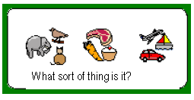

Developing ‘Active Listening’ in the Secondary School
‘Asking for Clarification’

Slide 50

Developing ‘Active Listening’ in the Secondary School

Slide 51




Developing ‘Active Listening’ in the Secondary School
‘3 Before Me!’
Brain
Buddy
Book

Slide 52
Developing ‘Vocabulary’ in the Secondary School
Desomation occurs when desom is transferred from one lipit to another. Danas, or dain, help in the process of desomation.
Using your own words – Create a sentence with the word ‘desomation’ in it, in order to show that you understand the word.

Slide 53
Developing ‘Vocabulary’ in the Secondary School
Desomation occurs when desom is transferred from one lipit to another. Danas, or dain, help in the process of desomation.
Using your own words – Create a sentence with the word ‘desomation’ in it, in order to show that you understand the word.

Slide 54

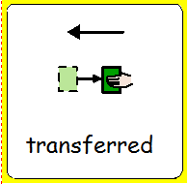


Desomation occurs when desom is transferred from one lipit to another. Danas, or dain, help in the process of desomation.
Using your own words – Create a sentence with the word ‘desomation’ in it, in order to show that you understand the word.

Slide 55

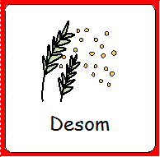



Desomation occurs when desom is transferred from one lipit to another. Danas, or the dain, help in the process of desomation.
Using your own words – Create a sentence with the word ‘desomation’ in it, in order to show that you understand the word.

